Slide 1

News from you?
My news
Homework checking

Slide 2
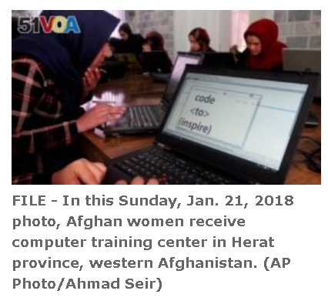
UN Celebrates International Women's Day
By Hai Do
07 March 2023

Slide 3
UN Celebrates International Women's Day
Who？
What？
When？
Where？
Why？

Slide 4
UN Celebrates International Women's Day
Who：Countries
What：are celebrating International Women's Day (IWD)
When：on Wednesday, March 8.
Where：around the world
Why：theme：DigitALL: Innovation and technology for gender equality

Slide 5
Countries around the world are celebrating International Women's Day (IWD) on Wednesday, March 8.
The United Nations says the theme it is celebrating this year is DigitALL: Innovation and technology for gender equality.

Slide 6
The U.N. says that from the earliest days of computing, women have contributed to information technology. But, it says those contributions have been little recognized or valued.
The international organization says 37 percent of women do not use the internet. It also says 259 million fewer women than men have access to the internet. Yet, women account for very close to half the world's population. The U.N. says women are largely underrepresented in science, technology, engineering and mathematics careers.

Slide 7
"Bringing women into technology results in more creative solutions and has greater potential for innovations that meet women's needs and promote gender equality," says the U.N.'s website.
For this year's International Women's Day, U.N. Secretary-General Antonio Guterres said in a statement, "Let us work together – across governments, the private sector and civil society – to build a more inclusive, just, and prosperous world for women, girls, men, and boys everywhere."

Slide 8
What Is International Women's Day?
The IWD has its roots in the social and labor movement in the United States.
It began in New York City on March 8, 1857, when female workers marched in protest of unfair working conditions and unequal rights in clothing factories. The workers called for a shorter workday and better pay, the National Archives says.
On March 8 of 1908, women workers again marched through New York City to protest child labor and poor working conditions, and demand women's right to vote.

Slide 9
The first recorded celebration internationally was on March 19, 1911, in Austria, Denmark, Germany and Switzerland. At that time, over a million people came out to support women's rights.
After World War II, several countries started to celebrate women's day on March 8. Two years later, the U.N. officially declared that date as International Women's Day in 1977. Some countries, including China, Russia and Uganda, also recognize it as a public holiday.

Slide 10
Past U.N. celebrations have included the issues of climate change, rural women and HIV/AIDS.
And, since 2007, the U.S. State Department has presented the International Women of Courage Award to more than 180 women in 80 countries.
I'm Jill Robbins.

Slide 11
News Headlines

Slide 12
Today…
Learn the grammatical characteristics of news headlines.
Learn the lexical and rhetorical features of news headlines.

Slide 13
Newspaper Headline (P25-28).
Concise
Expressive
Attractive
economical
informative
interesting

Slide 14

Functions of Headlines
1. Summarize the news content
2. Beautify the layout of the newspaper
编排, 版面

Slide 15
Search for the headlines
Search on the internet www.chinadaily.com.cn or the newspaper
and find some headlines with the characteristics we are going to discuss.
Try to interpret the headline.
Share with your partner.
Be ready to report to the whole class.

Slide 16
Layout of Headlines
Flush Left Headline左齐头式标题
Banner Headline通栏式标题
Drop Form Headline阶梯式标题
Inverted Pyramid Headline倒金字塔式标题
Double Headline双标题\复合式标题
Jump Head Headline转页式标题

Slide 17

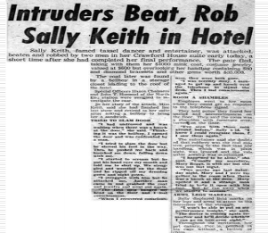
6. Jump Head Headline

Slide 18
Categories of Headlines Page 27
Direct
Indirect
News
How to
Question
Command
Reason why
testimonial

Slide 19
The Characteristics of Headlines
Acronym and Shortened words
words
grammar
rhetorical devices
colloquial and conversational words
Midget words are preferred.
The functional words are usually left out
Present tense indicates the past
Infinitives indicate the future
sound
metaphor
parody

Slide 20
The Characteristics of Headlines
The functional words are usually left out
Grammar
Page 40-42
Present tense indicates the past
Infinitives indicate the future

Slide 21
Grammar and Structure
The functional words are usually left out.
A
is
( ) Tourist ( ) Arrested for Espionage Charges
一游客涉嫌间谍活动被捕
is
( ) Forecast of Mexican Quake ( ) Accurate, but ( ) Ignored
The
it is
墨西哥地震预报准确，但未被注意

Slide 22
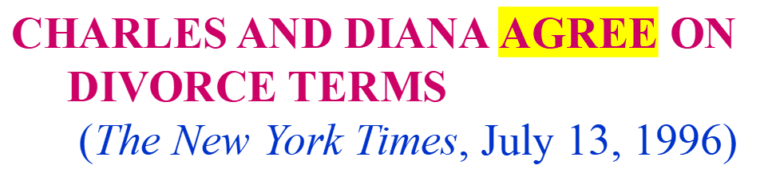
Grammar and Structure
Present tense the past
Infinitives the future.

Slide 23
Grammar and Structure
以现在分词表进行：
Gun-safety education facing many hurdles
过去分词表被动：
Aircraft carrier named after President Reagan
不定式表将来：
House To Vote on Economics Rules

Slide 24
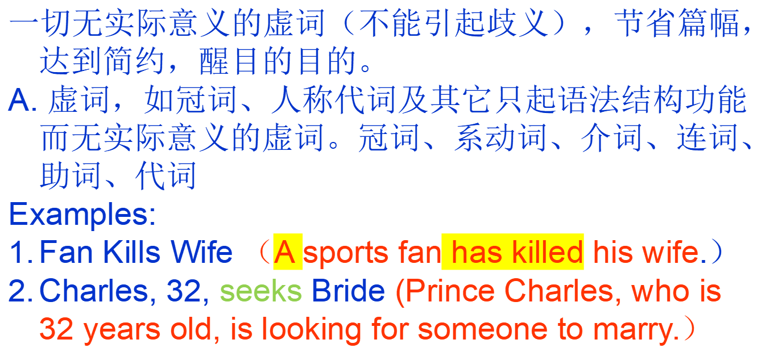
Grammar and Structure : Omission

Slide 25
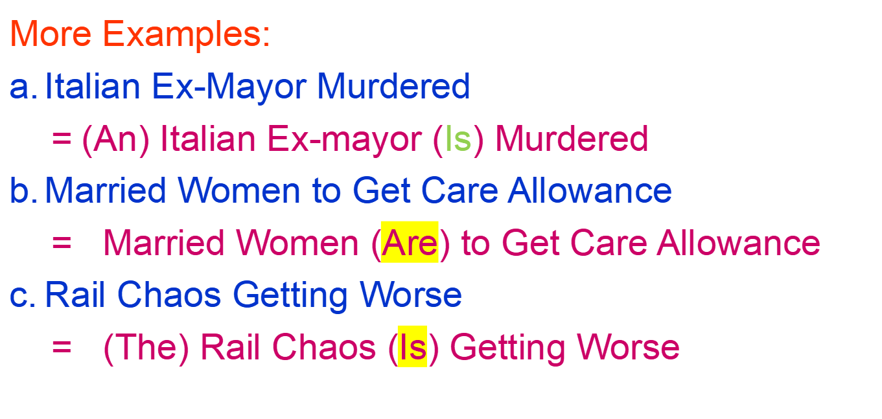
Grammar and Structure : Omission

Slide 26
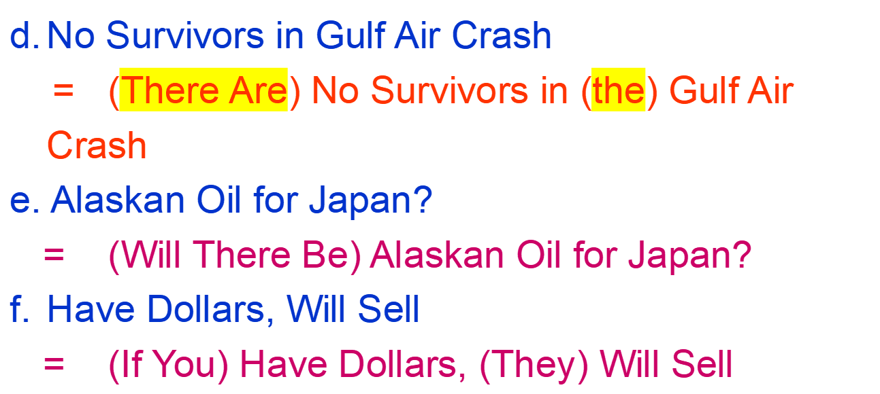
Grammar and Structure : Omission

Slide 27
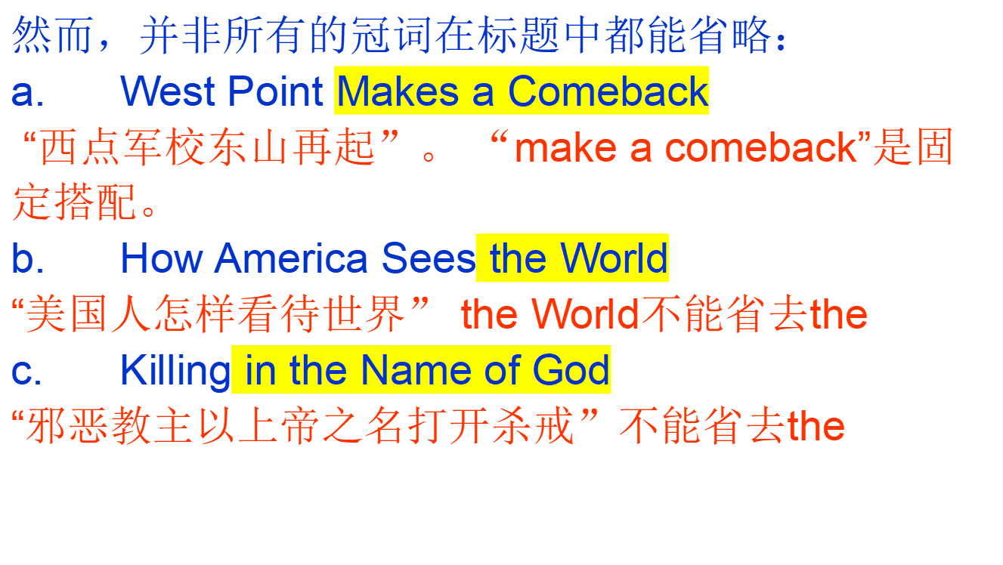
Grammar and Structure : Omission

Slide 28
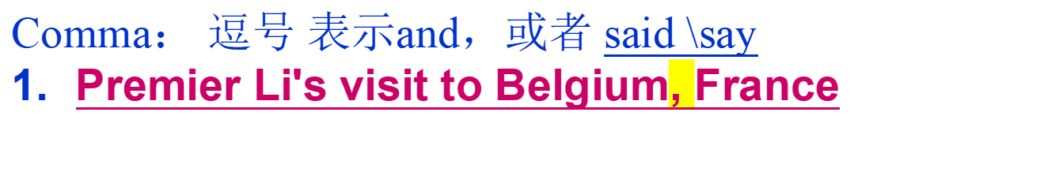
Grammar and Structure：punctuation

Slide 29
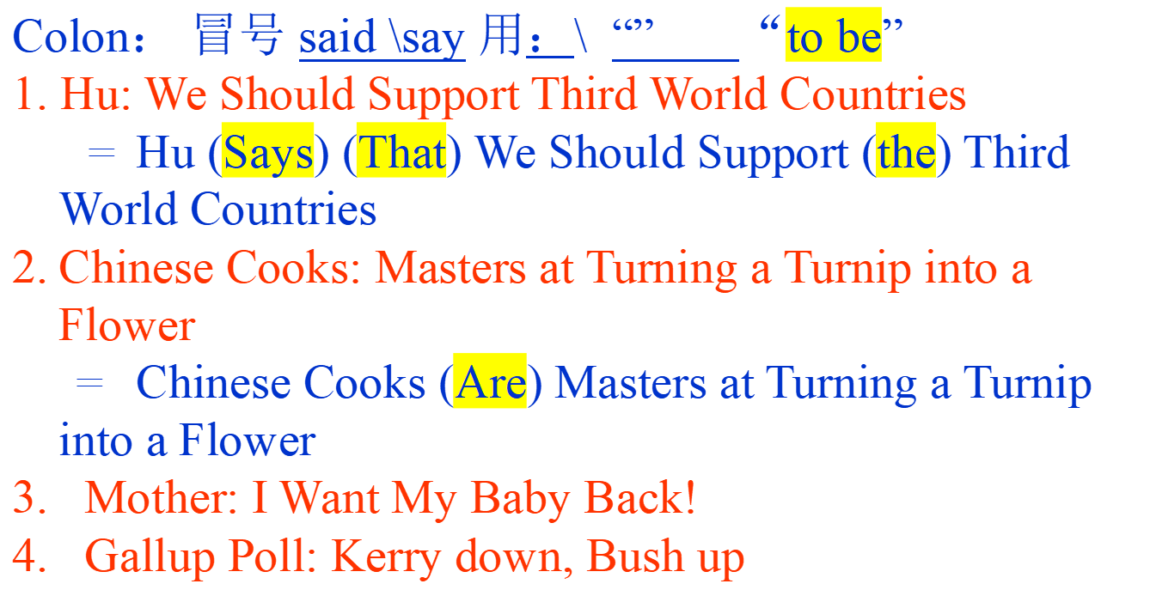
Grammar and Structure：punctuation

Slide 30
Grammar and Structure：punctuation
Quotation mark： 引号 “ ”
引号可表示引用某人所说的话，新闻的不确定性或表示引号内的词别有用义。
Example:
Teen killer was ‘angry young man’
China demands U.S. stop ‘interfering' on human rights
Bush unveils a ‘can do’ budget
Critics see ‘zero’ chance of U.N. tax

Slide 31
Grammar and Structure：punctuation
利用数字，省略其后众所周知的量词。
Examples:
41 die as school collapses
（其后明显省略了students）
Muller charged in fondling of boy, 14
（其后省略 years old）
Enforcers 15, Outlaws 13
（这种省略不看报道怎么能看懂？）

Slide 32
Words （Page 65-67）
Acronym and Shortened words
colloquial and conversational words
Midget（小） words are preferred

Slide 33




Exercise: Do you know the following
acronyms & shortened words?
ASEAN
CPPCC
UNESCO
UNSC
IOC
Association of Southeast Asian Nations
Chinese People’s Political
Consultative Conference中国人民政治协商会议
United Nations Educational, Scientific
and Cultural Organization
United Nations Security Council
International Olympic Committee

Slide 34


Exercise: Do you know the following
acronyms & shortened words?
WTO
WHO
UFO
PR
GMT
World Trade/Tourism Organization
World Health Organization
unidentified flying object
Public Relation 公共关系
Greenwich Mean Time 格林威治时间

Slide 35
Exercise: Do you know the following
acronyms & shortened words?
grad
Pro
Rep.
Expo
biz
Graduate 毕业生
Protein Province
Republic 共和国
Exposition 博览会
business

Slide 36
Acronyms 缩写词 P65-67
World Bank, IMF— Do They Help Or Hurt Third World
IMF= International Monetary Fund 国际货币基金组织
PM to see MPs over big factory closures
( The Times, 1981)
PM= Prime Minister
MPs= Members of Parliament
首相会见下议院议员商讨大工厂停闭问题

Slide 37
Acronyms 缩写词
QE2 may be sub’s target
(South China Morning Post, 1982)
“伊丽莎白二世女王号”可能遭潜艇攻击
QE2= Queen Elizabeth II;
sub= submarine
NATO to Seek New Secretary General
NATO: North Atlantic Treaty Organization
北大西洋公约组织
北约寻求新任秘书长

Slide 38
Shortened Words 节缩词
Weekly Mag for Stamp Lovers to be Launched
Mag= magazine
集邮周刊即将发行
New Groups Boost in Hi-tech Research
Hi-tech =High Technology
新兴集团推动高新技术研究

Slide 39
Colloquial and Conversational words
Iraq Gets OK to Sell $1.6 Billion in Oil
(USA Today，1998)
伊拉克获准出售16亿石油
8th NPC（人民代表大会） OKs Aid for Banks
(CHINA DAILY, 1998)
八届人大批准银行集资
Uncle Sam, bar the door
(U.S. News & World Report April 29, 1996)

Slide 40
Colloquial and Conversational words
Chinese Web Opens Portals to New Way of Life
Booming Internet Splits Haves and Have-Nots
(Washington Post，Feb 13, 1998)
中国的网络开启了新的生活方式之门
Haves and Have-Nots “有钱人和没钱人”
Doing Business The Dot-Com （网络公司） Way
(Fortune，cover story of March, 2000)

Slide 41
Midget Words 简短小词
Unions Back Peace Move
Back: support
Nuclear Blast Seepage Is Found
(The New York Times, 1999)
Blast: explosion
核爆炸渗漏物被发现
Quake Death Toll May Top 2000
= The Death Toll in the Earthquake may exceed 2000

Slide 42
Rhetoric Devices: sound (P53-54)
alliteration 头韵, repetition 重复, rhyme押韵
Metaphor 比喻 is
Parody 戏仿
---套用名言﹑典故﹑谚语和文学著作之名

Slide 43

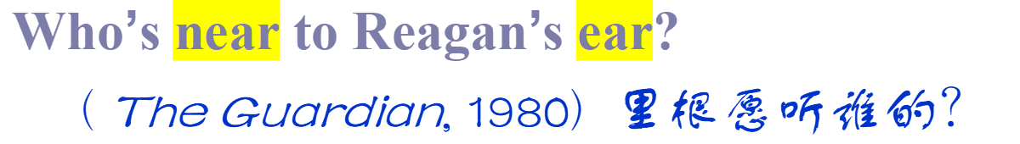


Rhetoric Devices: sound
alliteration 头韵, repetition, rhyme押韵

Slide 44
(Wall Street is catching Asian Financial crisis)

Slide 45

Rhetoric Devices: Parody
---套用名言﹑典故﹑谚语和文学著作之名
A Tale of Two Debtors
(The Economist , Jan 22,2000)
A Tale of Two Hearts
Charles Dickens “A Tale of Two Cities”双城记

Slide 46

Rhetoric Devices: Parody
---套用名言﹑典故﹑谚语和文学著作之名
Candidate in the Wind
Gone with the Wind
( Feb 7, 2000 The Washington Post)
TO SAVE OR NOT TO SAVE
Shakespeare’s Hamlet
“To be or not to be”

Slide 47
Appreciate the following headlines.
Cease-fire announced in Angola
Woman kills husband, herself
A Cease-fire is/was announced in Angola

Slide 48

Poll: McCain loses lead in rural American voters
AIDS a modern killer--- British professor
A British professor says AIDS is a modern killer

Slide 49
Match these newspaper headlines with the following categories (some headlines fit two categories). Then try to “translate” the meaning of each of the headlines.
Noun Phrases
Noun Strings
Simple Tenses instead of Continuous or Perfect
Auxiliary Verbs Dropped in Passive Form
Articles Dropped
Infinitive to Indicate Future
Difficult Times Ahead
Forgotten Brother Appears
James Wood to Visit Portland
Landscaping Company Disturbance Regulations
Man Killed in Accident
Mayor to Open Shopping Mall
Mustang Referral Customer Complaint

Slide 50
Noun Phrases
Noun Strings
Simple Tenses instead of Continuous or Perfect
Auxiliary Verbs Dropped in Passive Form
Articles Dropped
Infinitive to Indicate Future
Overwhelming Response of Voters
Passerby Sees Woman Jump
President Declares Celebration
Professors Protest Pay Cuts
Tommy the Dog Named Hero
Under Pressure from Boss
Unexpected Visit
Widow Pension Pay Committee

Slide 51
Activity 1: News Headlines Appreciation
Work in groups.
Analyze the writing features of the headlines. Which is the most interesting/impressive headline in your group?
Report and explain.

Slide 52
Activity 2：
Listen and decide the headline
Listen to the following two pieces of news. Try to make a headline for each one of them first.
Match the news with their headlines.

Slide 53
News item 1
Ukraine to Form New Government
Ukraine Forms New Government
News item 2
U.S. Sanctions Reimposed on Iran
U.S. Sanctions Reimposes on Iran

Slide 54
News item 1
Ukraine to Form New Government
Ukraine Forms New Government
The United States welcomes Ukraine’s announcement that it has formed a new government. “This sets the stage for the difficult but necessary process of implementing reforms and delivering results,” said Vice President Joe Biden.

Slide 55
News item 2
U.S. Sanctions Reimposed on Iran
U.S. Sanctions Reimposes on Iran
As promised, President Donald Trump has re-imposed a series of U.S. nuclear-related sanctions on Iran that had been lifted under the nuclear deal, known as the Joint Comprehensive Plan of Action.

Slide 56
Part 2 News Reading

Slide 57


Read the headline
who
what
Brown unveils plan to give
over-65s post-hospital care
offering up to six weeks of support means people could stay at home for longer, says PM
Prime Minister
Sub-headline

Slide 58
News lead (pa. 1)
what
Lead: People aged over 65 could be given
up to six weeks’ support to enable them to
remain in their own homes after a stay in
hospital or residential care, or a fall or an
illness, Gordon Brown said today.
why
who
when

Slide 59
Homework 1
1. Group task： Each group should
1. explain its part, and summarize its main idea.
2. raise at least one question concerning this part and invite next group to answer it.
Group 1 Part 1: Para 1-2
Group 2 Part 2: Para 3-8
Group 3 Part 3: Para 9-12
Group 4 Part 4: Para 13-16
Group 5 Part 5: Para 17-19
Group 6: the structure of the whole news report

Slide 60
Homework 2
2. Read Useful Information Part in the textbook and finish 新闻基础知识练习2 and 3.
In Unit 2: Headlines (P25-28).
In Unit 3 :Headlines: Grammar Issues (P40-42).
In Unit 4 Headlines: Rhetorical devices (Page 53-55).
In Unit 5: Headlines: Lexical Features (Page 65-67).

